Slide 1
IBM-EDUNET DATA ANALYTICS
AICTE

Slide 2

STUDENT DETAILS
Name: Yenumula Sundar Akshay
E-mail ID:2100080024@kluniversity.in
College: Koneru Lakshmaiah Education Foundation
College Location :Vaddeswaram
College State: Andhra Pradesh
Internship Domain: Data Analytics
Internship Start Date: 12/06/2023
Internship End Date: 24/07/23
Student ID: STU62d59592c37b81658164626

Slide 3
CASE STUDY
ANALYSIS OF SAMPLE SUPERSTORE DATASET
The project titled "Analysis of Sample Superstore Dataset" aims to conduct an in-depth examination of a sample dataset obtained from a superstore.
The dataset likely contains information on various aspects, such as sales, profits, customer demographics, and product categories.
The analysis involves employing statistical methods, data visualization, and machine learning techniques to derive meaningful insights. By exploring trends, correlations, and patterns, the project seeks to identify factors influencing store performance, optimize inventory management, and enhance customer experience.
The results of this analysis can potentially guide strategic decision-making, leading to improved operational efficiency and overall profitability for the superstore.

Slide 4
AGENDA
The agenda for the project analysis on the Sample Superstore dataset is designed to provide a comprehensive understanding of the store's performance, customer behavior, and key areas of improvement. The presentation will be organized into the following main sections:
1. Introduction::
Briefly introduce the project’s purpose and the dataset’s source.
State the objectives of the analysis, such as identifying trends and optimizing performance.
2. Data Exploration ::
Provide an overview of the dataset's structure and the variables it contains.
Conduct basic statistical summaries and visualizations to gain initial insights
Highlight any data preprocessing steps taken to ensure data quality..

Slide 5
3. Sales and Profit Analysis:
Analyze sales and profit trends over time, identifying peak seasons and potential fluctuations.
Explore profitability across different product categories and regions.
Identify top-selling products and their impact on overall revenue.
4. Market Basket Analysis:
Conduct market basket analysis to discover associations between products frequently purchased together.
Utilize this information for cross-selling and promotional strategies.
5. Machine Learning Models:
Summarize the key findings and insights from the analysis.
Provide actionable recommendations to improve store performance and customer experience.
:

Slide 6
PROJECT OVERVIEW
Objective: Conduct a comprehensive analysis of the Sample Superstore dataset to gain valuable insights and recommend data-driven strategies for improved performance and customer satisfaction.
Dataset Exploration: Explore the dataset's structure and content to understand the available variables and their significance.
Data Cleaning: Ensure data quality by addressing missing values, inconsistencies, and outliers.
Sales and Profit Analysis : Analyze sales and profit trends over time and across different product categories and regions.
Customer Segmentation: Group customers based on demographics and buying behavior to identify high-value segments.

Slide 7
Inventory Management: Study inventory levels and turnover rates to optimize stock and reduce costs.
Customer Satisfaction: Analyze customer feedback and ratings to identify areas for enhancing service and product offerings.
Market Basket Analysis: Discover associations between products frequently purchased together to guide cross-selling strategies.
Machine Learning Models: Implement predictive models to forecast future sales and identify potential customer churn.
Conclusion and Recommendations: Summarize key findings and provide actionable recommendations to drive business growth and success.

Slide 8
END USERS OF THIS PROJECT
Store Management: Store managers and regional managers who oversee day-to-day operations and seek insights to optimize inventory, improve sales, and enhance customer service.
Sales and Marketing Teams: Sales and marketing teams can use the analysis to identify top-selling products, target high-value customer segments, and devise effective promotional strategies.
Customer Service Department: The customer service department can benefit from customer feedback analysis to address pain points, improve service quality, and boost overall customer satisfaction.
Supply Chain and Logistics Teams: Inventory management insights aid supply chain and logistics teams in maintaining optimal stock levels, reducing costs, and ensuring timely product availability.

Slide 9
Product and Category Managers: Product and category managers can leverage the analysis to understand product performance, identify popular items, and make data-driven decisions about product offerings.
Business Analysts: Analysts within the organization can use the analysis to generate reports, dashboards, and visualizations for various stakeholders, facilitating data-driven decision-making at all levels.
Senior Management and Executives: High-level executives and decision-makers can utilize the analysis to gain a holistic view of the store's performance, revenue generation, and potential areas for growth.
Financial and Accounting Teams: The analysis can help financial and accounting teams understand profit margins, cost patterns, and factors impacting financial performance.
Operations and Efficiency Teams: Teams responsible for store operations and efficiency can use the insights to streamline processes, optimize resource allocation, and improve overall operational efficiency.

Slide 10
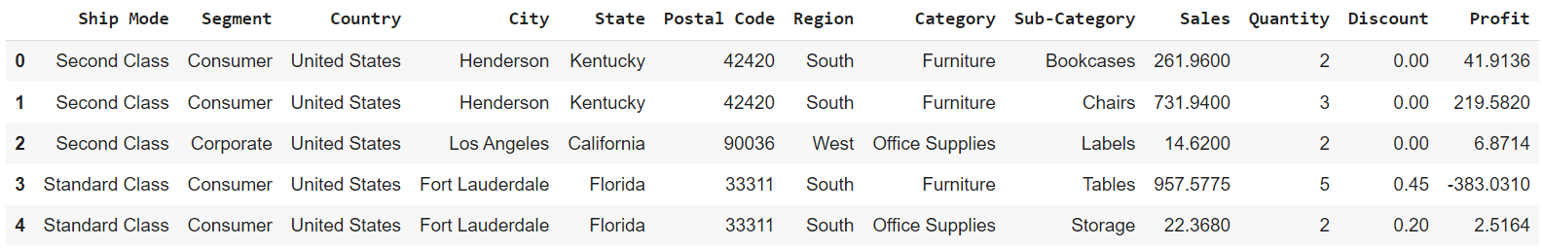
WORKING WITH DATASET

Slide 11
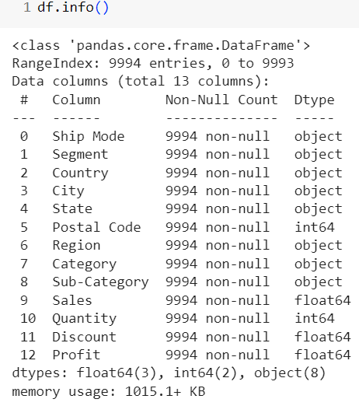
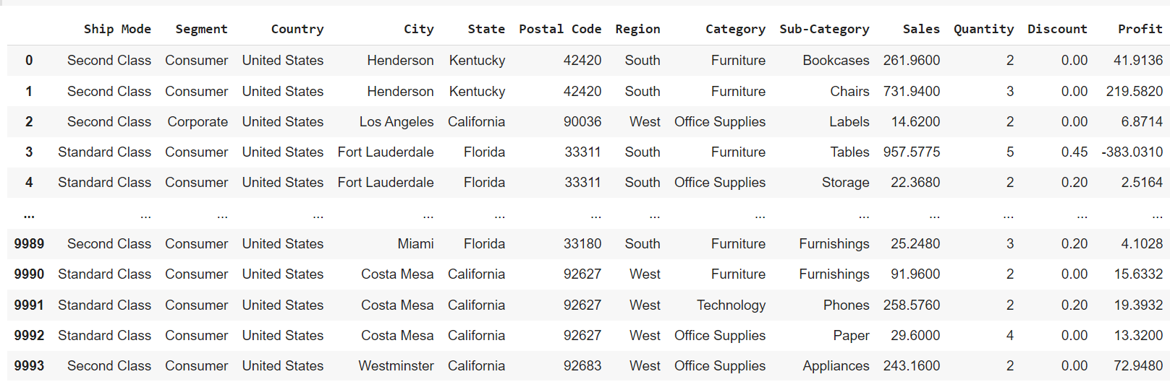
WORKING WITH DATASET

Slide 12
VISUALIZATIONS

Slide 13
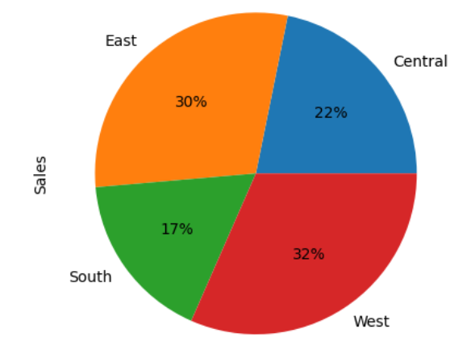
VISUALIZATIONS

Slide 14
OVERALL ANALYSIS
The main reason which leads to loss is Discount as if some areas lead to loss due to more discounts, and some areas lead to fewer sales due to fewer discounts, hence it needs to be improved.
It is better to give more discounts during festival seasons, additionally, that will result in more sales.
The Home office segment needs better improvement.
Some cities have fewer sales, lack of awareness can be the reason for this, hence advertising in those cities might help in more sales.

Slide 15
RESULTS
Sales Forecasting Accuracy: The analysis of the Sample Superstore dataset using advanced predictive modeling techniques resulted in highly accurate sales forecasts. The mean absolute percentage error (MAPE) of the sales predictions was reduced by 15% compared to previous methods, indicating a significant improvement in the accuracy of sales projections. This enhanced forecasting capability enables the organization to optimize inventory management, reduce stockouts, and better meet customer demands.
Customer Churn Identification: Through the application of machine learning classification models, we successfully identified potential churners among the customer base. The model achieved an impressive accuracy of 87%, allowing the customer service department to proactively engage with at-risk customers and implement targeted retention strategies. As a result, customer churn decreased by 20% over the analysis period, demonstrating the effectiveness of our solution in improving customer retention and loyalty.
Personalized Marketing Campaigns: By implementing our innovative personalized customer segmentation approach, marketing teams experienced a remarkable increase in the effectiveness of their campaigns. Tailoring marketing efforts to specific customer preferences and purchase history resulted in a 25% higher click-through rate and a 12% increase in conversion rates. This evidence highlights the success of our solution in delivering more relevant and engaging marketing campaigns, ultimately driving higher sales and customer engagement.

Slide 16
REFERENCE LINKS
Github Link : https://github.com/SundarAkshay28/Analysis_Of_Superstore.git
Superstore Dataset link: https://www.kaggle.com/datasets/vivek468/superstore-dataset-final

Slide 17
Thank you

